Slide 1
Fiber Optics

Slide 2
Introduction
Optical fiber is a long thin transparent dielectric material which carries EM waves of visible and IR frequencies from one end to the other end of the fiber by means of Total Internal Reflection.
Glass or Plastic is used as Dielectric material.
Optical fibers works as Wave guides in optical television signals, digital data to transmit voice television signals, digital data to any desired distance from one end to the other end of the fiber.

Slide 3
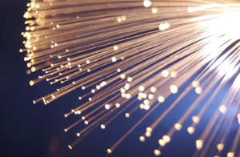
What are Fiber Optics?
Fiber optics (optical fibers) are long, thin strands of very pure glass about the diameter of a human hair.
They are arranged in bundles called optical cables and used to transmit light signals over long distances.
Fiber Optics are cables that are made of optical fibers that can transmit large amounts of information at the speed of light.

Slide 4
Optical fiber consists of three sections
1. Core 2. Cladding 3. Protective Jacket
Core: It is an inner cylindrical material made up of glass or plastic.
Cladding: It is a cylindrical shell of glass or plastic material in which Core is inserted.
Protective Jacket: The Cladding is enclosed in polyurethane jacket and it protects the fiber from surroundings.
The RI of core is slightly greater than the RI of Cladding. The normal standard values are 1.48 and 1.46 respectively.

Slide 5
Structure of an Optical fiber
Poly urethane protective jacket
Cladding
Core
glass or plastic
cladding
plastic jacket
fiber core

Slide 6
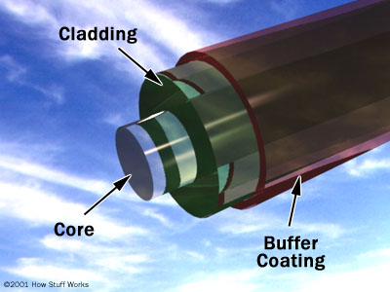

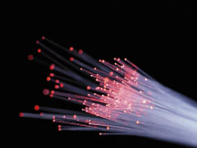
Fiber Optic Cables
SOURCE: SURFNET.NL

Slide 7
How Does Optical Fiber Transmit Light??
Principle: Optical fiber works on the principle of TIR. Once light ray enters into core ,it propagates by means of multiple TIR’ s at core-cladding interface.
The light in a fiber-optic cable travels through the core (hallway) by constantly bouncing from the cladding (mirror-lined walls), a principle called total internal reflection.
Because the cladding does not absorb any light from the core, the light wave can travel great distances.
However, some of the light signal degrades within the fiber, mostly due to impurities in the glass. The extent that the signal degrades depends on the purity of the glass and the wavelength of the transmitted light

Slide 8


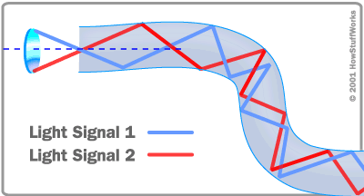
How Does an Optical Fiber Transmit Light?
Total Internal Reflection

Slide 9
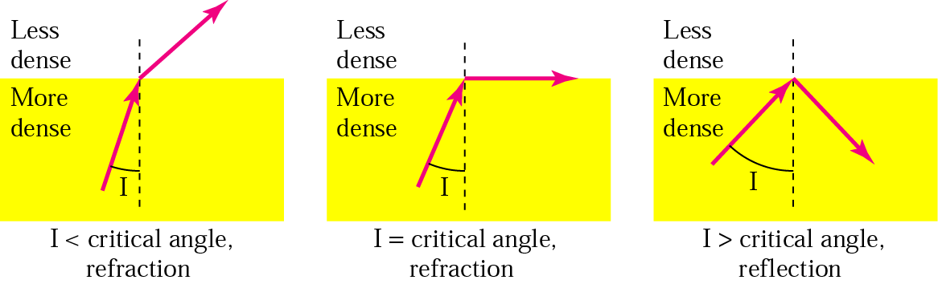
Total Internal Reflection
Physical Media

Slide 10
